Slide 1
https://codeburst.io/algorithms-i-searching-and-sorting-algorithms-56497dbaef20

Slide 2
CSS143 Computer Programming (II)

Slide 3
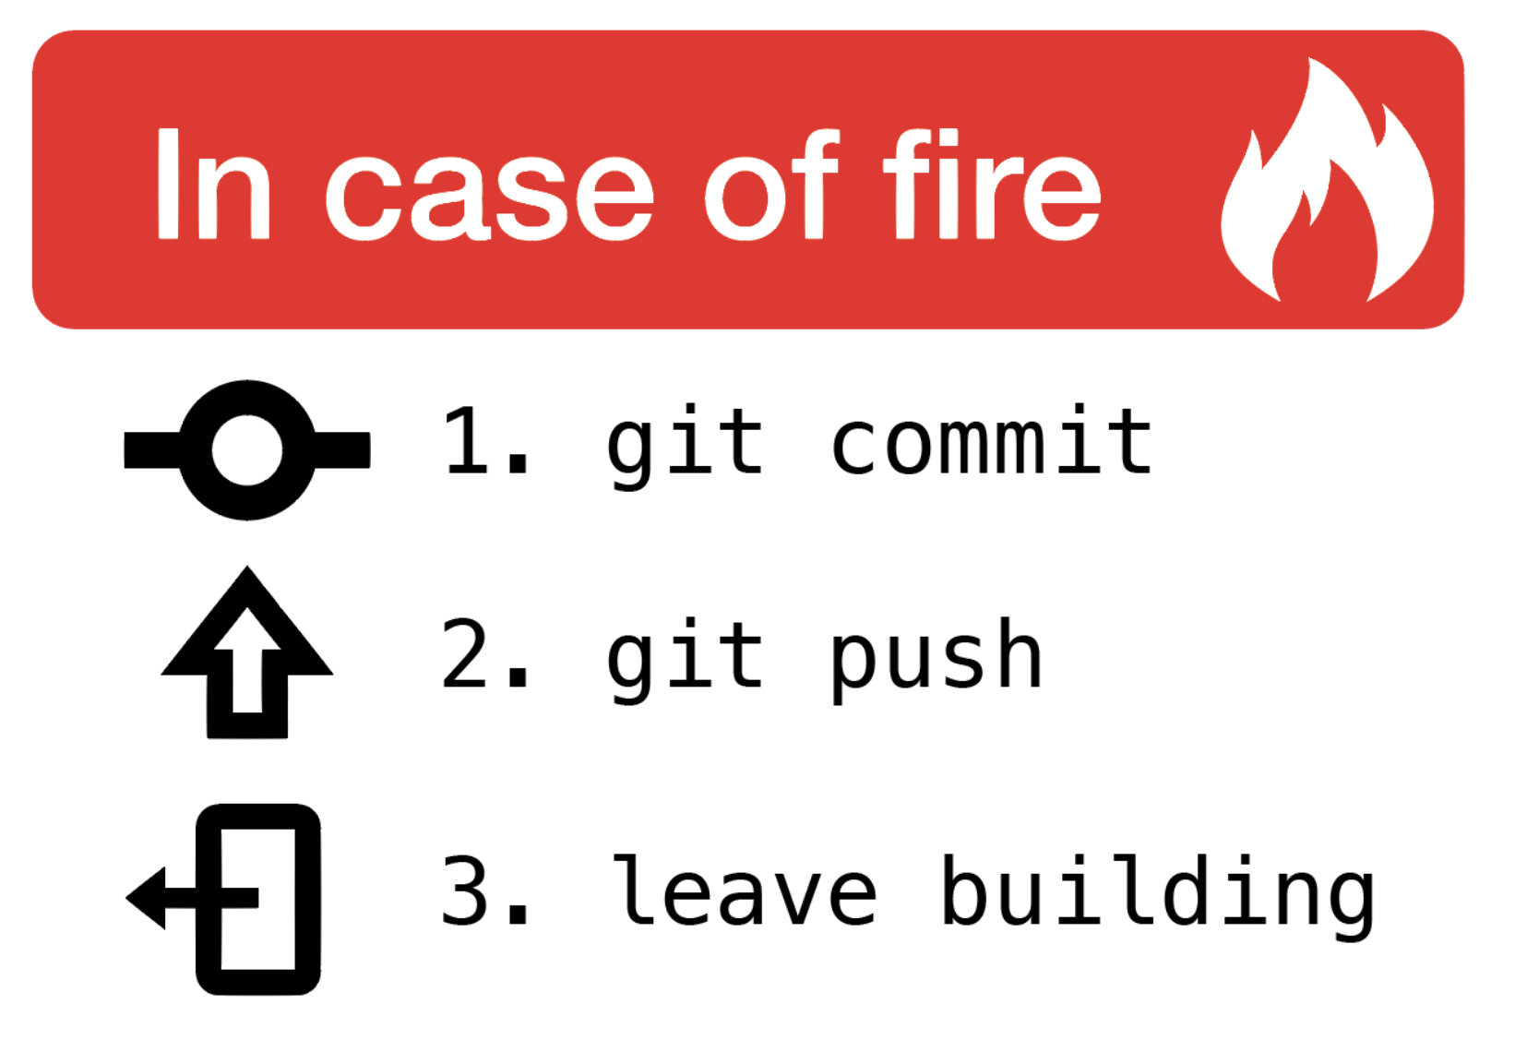

Slide 4
A Search Problem (sorted array)
Target: 14
1
3
5
7
9
10
12
12
14
14
18
0
1
2
3
4
5
6
7
8
9
O(log₂N)
log₂10 = 3.322 comparions
Worst case

Slide 5
A Search Problem (random array)
Target: 14
18
12
1
7
5
10
3
12
9
14
14
0
1
2
3
4
5
6
7
8
9
O(N)
N = 10 comparisons
Worst case

Slide 6
A Search Problem
Can we do better than O(N) for a random set of numbers?
Option 1: Change the way we do it
Option 2: Change how we store it

Slide 7
A Search Problem
Can we do better than O(N) for a random set of numbers?
Option 1: Change Algorithm
Option 2: Change Data Structure

Slide 8
A Search Problem
Option 1: Change Algorithm
18
12
1
7
5
10
3
12
9
14
14
0
1
2
3
4
5
6
7
8
9
Sort
O(N²) to O(N log₂N)
1
3
5
7
9
10
12
12
14
14
18
0
1
2
3
4
5
6
7
8
9

Slide 9
A Search Problem
Option 1: Change Algorithm
First Sort
Then Search
O(N log₂N)
10 * log₂10 = 33.22 comparisons
O(log₂N)
log₂10 = 3.32 comparisons
Linear search is O(N)
10 comparisons

Slide 10
Option 2: Change how we store it
data is automatically sorted when it’s generated
13
1
1
3
3
5
5
7
7
9
9
10
10
12
12
12
12
14
13
18
14
18
When there’s data, insert it into the sorted place
When search, use binary search
O(log₂N) with shuffling
O(log₂N) with shuffling
O(log₂N)

Slide 11
Option 2: Change how we store it
Array → Shuffling
What about other data structure instead?
1
3
3
5
7
9
9
10
12
12
12
14
18
0
1
2
3
4
5
6
7
8
9
3
9
12
9
3
12
1
5
10
14
7
12
18

Slide 12
Option 2: Change how we store it
13
9
9
13
3
12
13
1
5
10
14
13
7
12
18
13
13
When there’s data, insert it into the sorted place
When search, binary sort traverse the tree
O(log₂N) with shuffling
O(log₂N)

Slide 13
Option 2: Change how we store it
Target: 14
?
9
9
?
3
12
1
5
10
14
?
14
7
12
18
Binary Search
Tree

Slide 14
Option 2: Change how we store it
Target: 3
8
12
1
7
5
10
3
11
9
2
“Does 3 exist in the given set of numbers?”

Slide 15
Organizing Things
Idea: separate things into buckets/bins/folders

Slide 16
Option 2: Change how we store it
8
12
1
7
5
10
3
11
9
2
Target: 3
0
1
2
3
4
5
6
7
8
9
10
11
12

Slide 17
Option 2: Change how we store it
8
12
1
7
5
10
3
11
9
2
Target: 3
Target: 4
0
1
2
3
4
5
6
7
8
9
10
11
12
0
1
1
1
0
1
0
1
1
1
1
1
1
insert
search
O(1)
O(1)

Slide 18
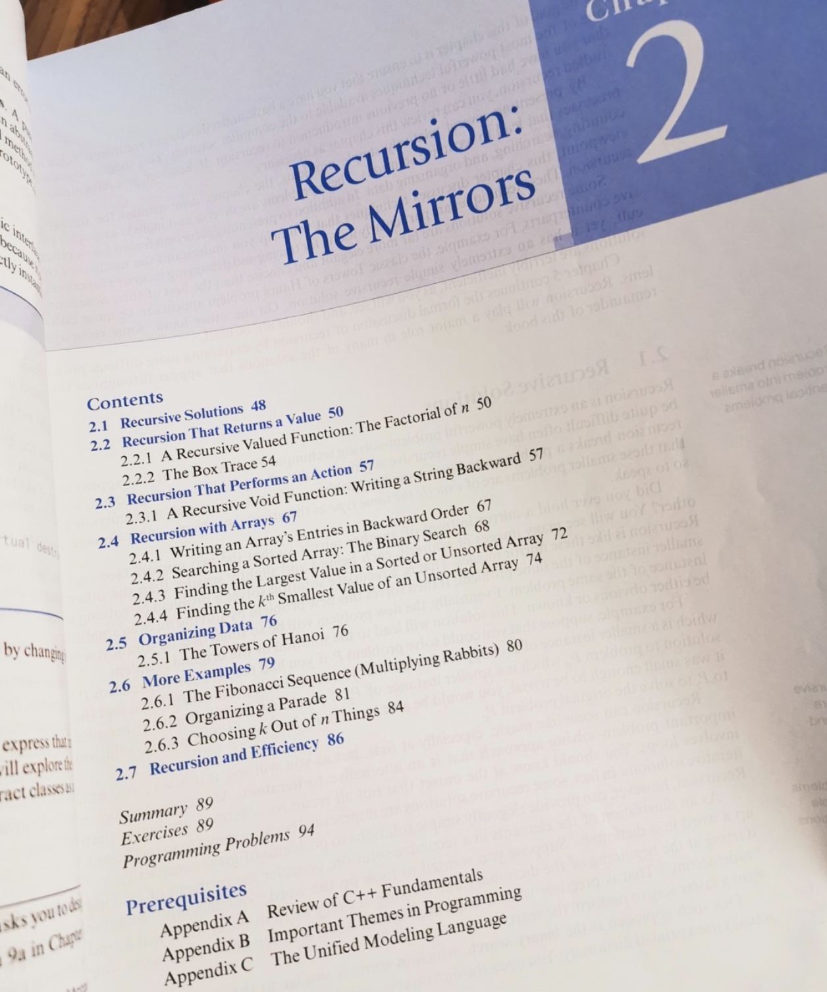
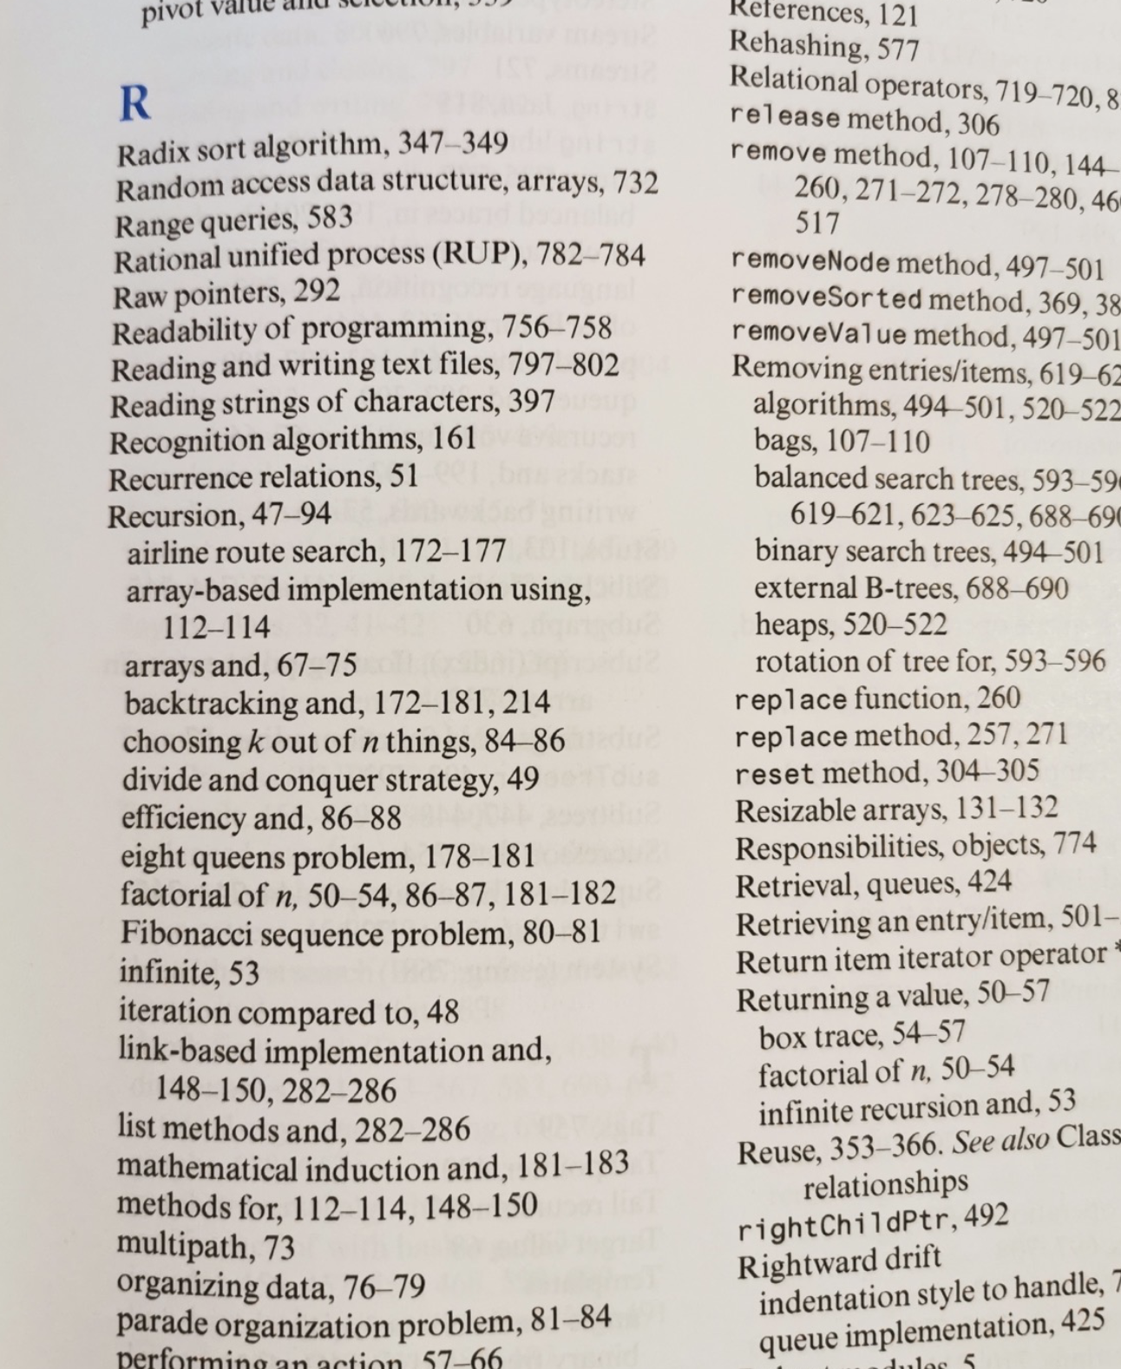
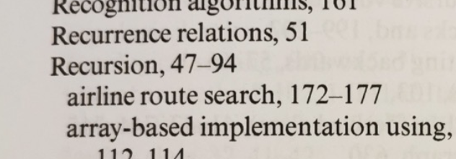
An Example
Book Index

Slide 19
An Example
Book Index
topic
pages

Slide 20
An Example
Book Index
topic
pages
“recursion” ?
“binary tree” ?
“Pioneer Square” ?
1. Does topic exist?
2. Where is the topic located in the book?

Slide 21
An Example
key
value
topic
pages
Book Index
Key = “keyword”
topic “recursion”
recursion
list
tree
47
Also how database indexing works. See this for more.

Slide 22
A Search Problem
Given a key, find the value from a set of key-value pairs
0
Key1
value1
Key x
O(1) search
1
Key2
value2
Key x
hash function
array index
O(1) search
…
…
…
N
KeyN
valueN

Slide 23
A Search Problem
Given a key, find the value from a set of key-value pairs
0
Key1
value1
1
Key2
value2
Key x
O(1) search
…
…
…
N
KeyN
valueN
google
Dictionary

Slide 24
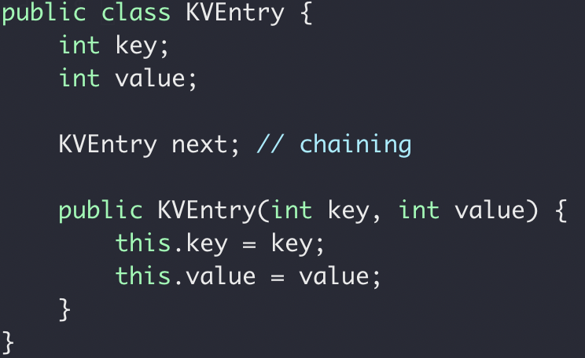
Dictionary ADT
Key x
Value x
Node

Slide 25
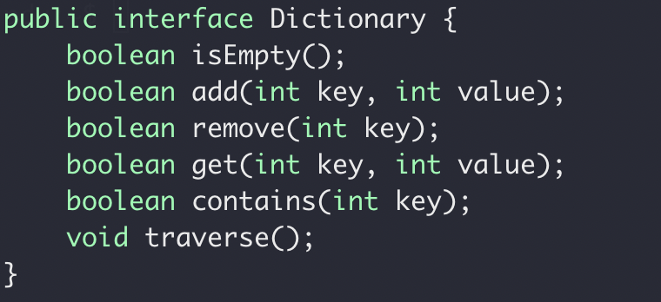
Dictionary ADT
Key1
value1
Key2
value2
…
…
KeyN
valueN
Interface

Slide 26
Dictionary ADT
Implementation
O(1) insert and search ➔ Array
0
Key1
value1
1
Key2
value2
Key x
X → array index
Index y
…
…
…
N
KeyN
valueN
Key
hash_function {}
Array index

Slide 27
Dictionary ADT
0
Key1
value1
1
Key2
value2
…
…
…
N
KeyN
valueN
Key x
Index y
“Entry Key”
“Hash Key”

Slide 28
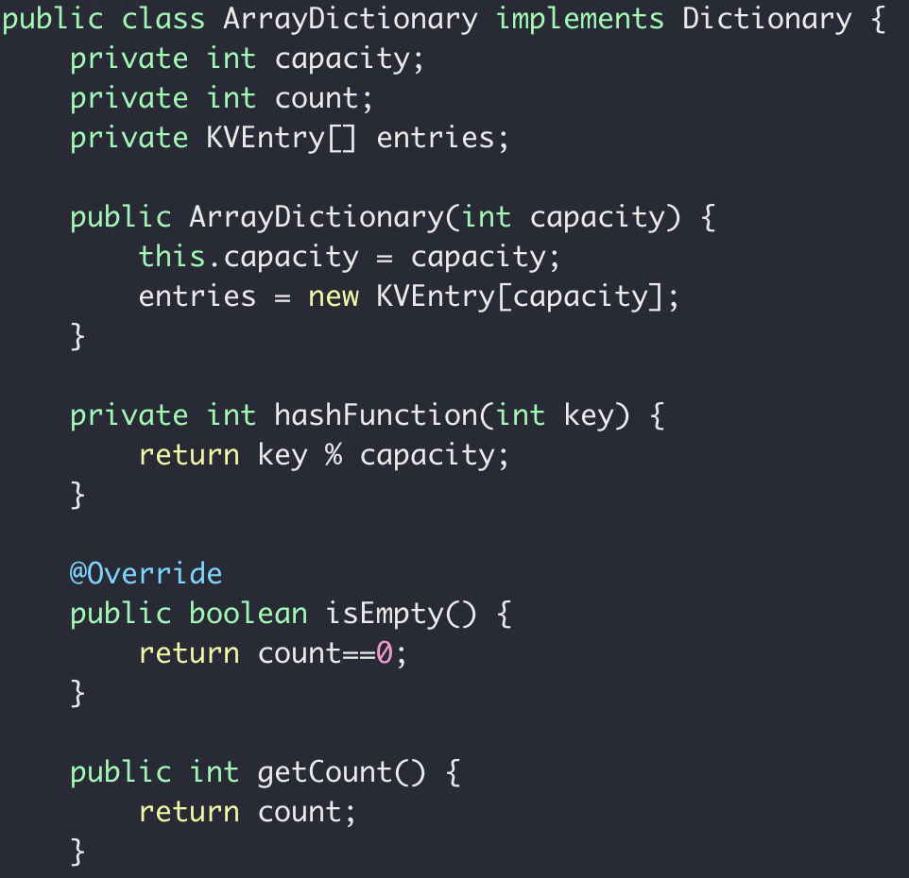
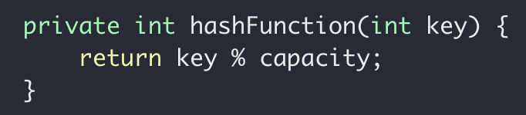
Dictionary ADT
Implementation
Key1
value1
Key2
value2
…
…
KeyN
valueN

Slide 29
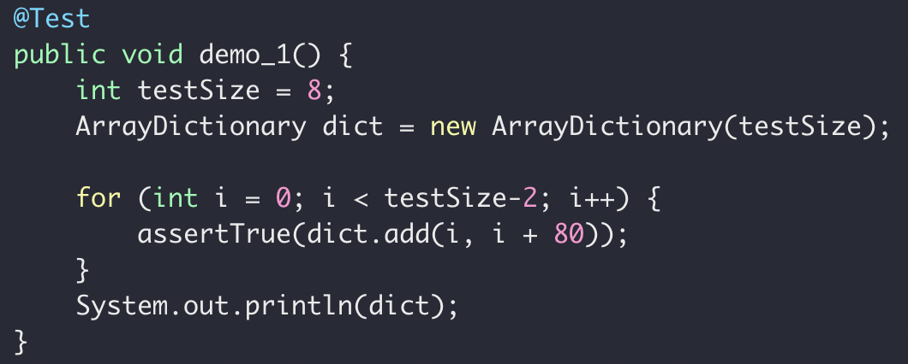
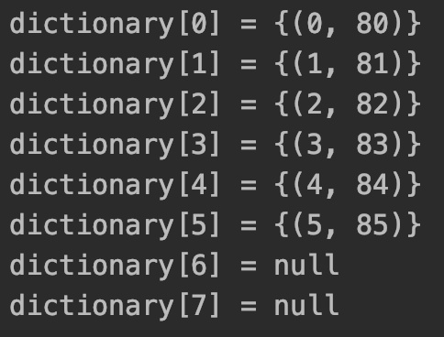
Some tests

Slide 30
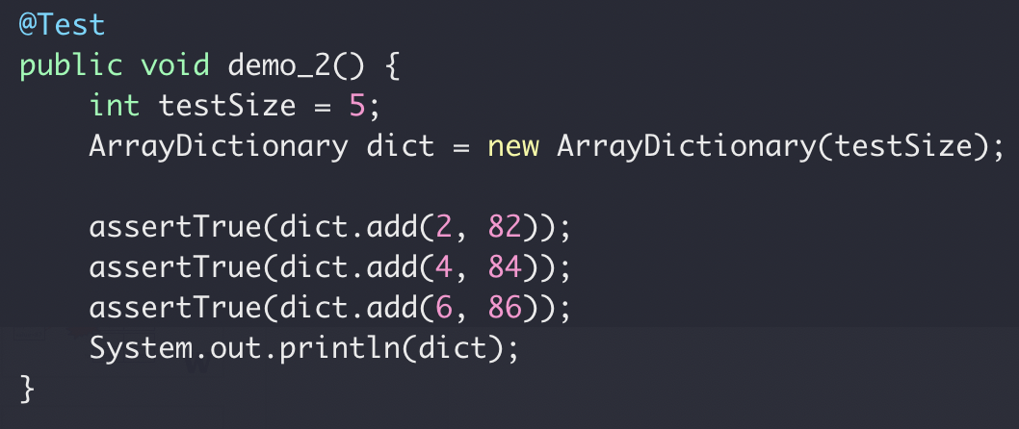
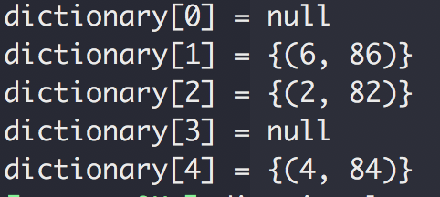
Some tests

Slide 31
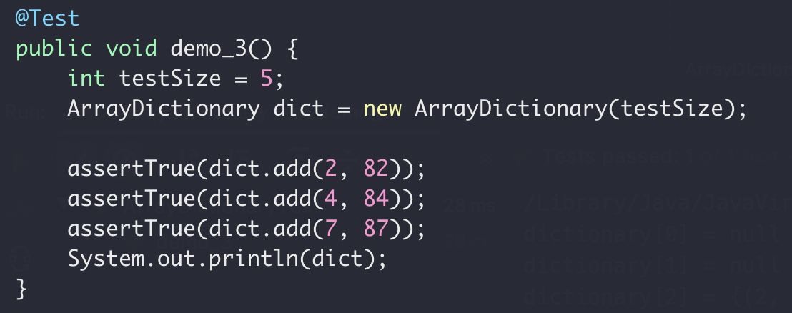
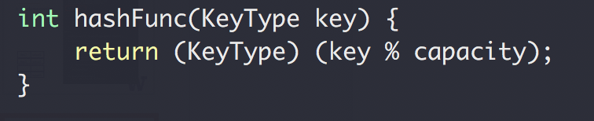
Some tests
1 % 5 → 1
2 % 5 → 2
3 % 5 → 3
4 % 5 → 4
5 % 5 → 0
6 % 5 → 1
7 % 5 → 2

Slide 32
Dictionary ADT
0
Key1
value1
1
Key2
value2
key=2
value=86
Key3
value3
2
2
86
collision
3
Key4
value4
key=7
value=87
…
…
…
N
KeyN
valueN

Slide 33
Collision
Three approaches
Better hashing algorithm
Find another location in the table
3. Modify the entry to be able to hold more than one set of values
https://medium.com/basecs/hashing-out-hash-functions-ea5dd8beb4dd

Slide 34
Collision
The second approach
Find another location in the table
0
key=2
value=86
1
2
2 → 86
key=7
value=87
3
7 → 87
4
“open addressing”

Slide 35
Collision
Two approaches
2. Make entry keep multiple key/value pairs
0
key=2
value=86
1
2
2 → 86
7 → 87
17 → 97
key=7
value=87
3
4
“chaining”
key=17
value=97

Slide 36
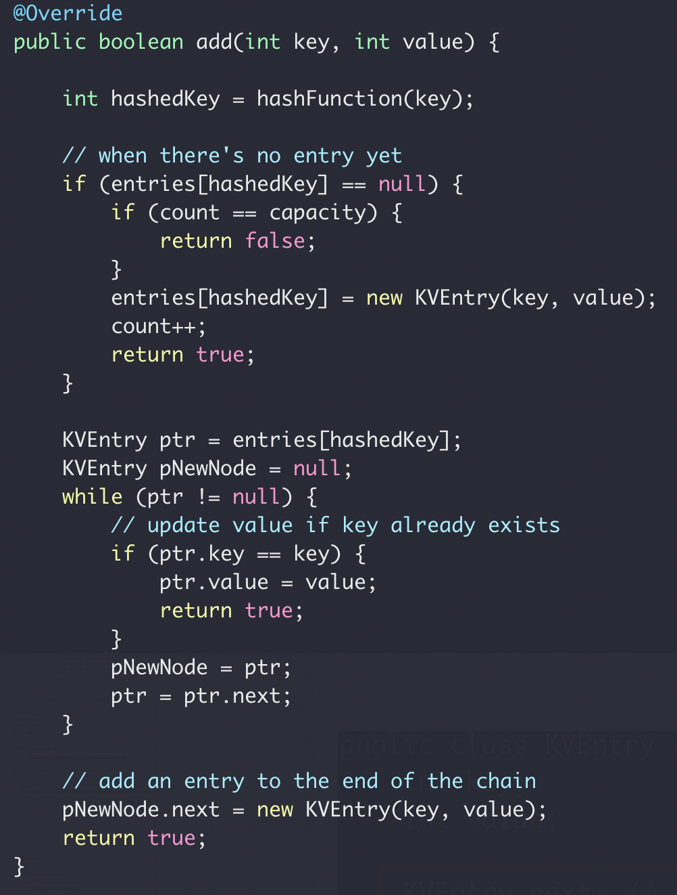
Chaining for collision

Slide 37
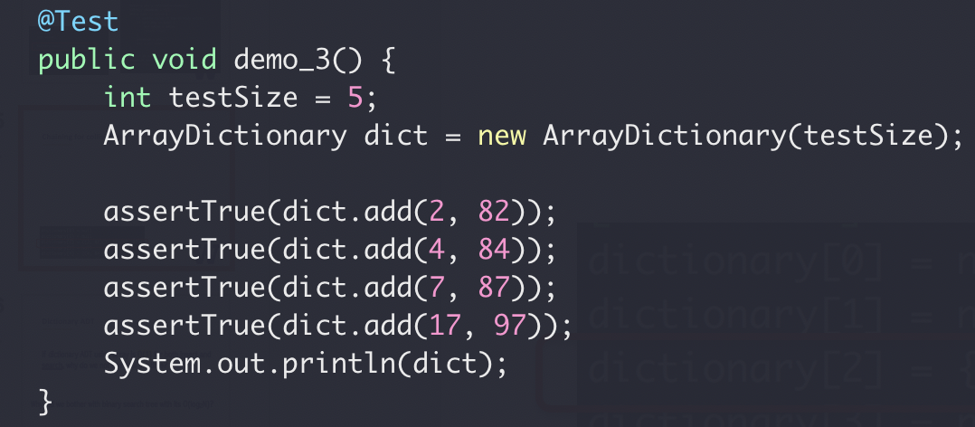
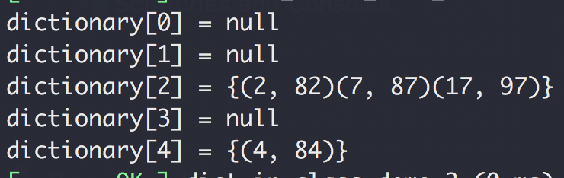
Chaining for collision key

Slide 38
Dictionary ADT
If dictionary ADT using array is O(1) for both insert and search, why do we not use it all the time?
Why did we bother with binary search tree with its O(log₂N)?

Slide 39
Dictionary ADT
If dictionary ADT using array is O(1) for both insert and search, why do we not use it all the time?
Why did we bother with binary search tree with its O(log₂N)?
SORTED

Slide 40
Dictionary ADT Containers
Unsorted containers
Array
using array index as hash key
Sorted containers
Binary Search Tree
using hash key value to determine location in the tree
Sorted Array
Data shuffling for insert
Query for one key
Query for range of keys with some order

Slide 41
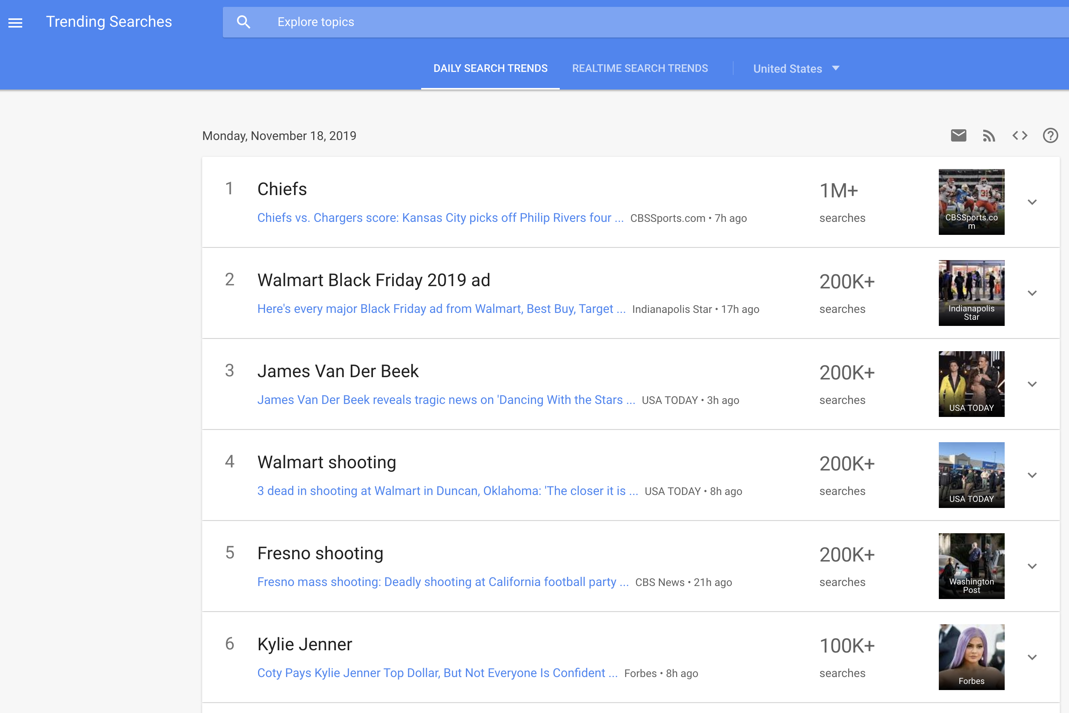
Word Frequency
Given a set of words, count how many times each word appears, and show them in descending order
https://trends.google.com/trends/trendingsearches/daily?geo=US

Slide 42
Word Frequency
Give a text of words
You can't handle the truth! Son, we live in a world that has walls, and those walls have to be guarded by men with guns. Who's gonna do it? You? You, Lieutenant Weinberg? I have a greater responsibility than you can possibly fathom. You weep for Santiago and you curse the Marines. You have that luxury. You have the luxury of not knowing what I know, that Santiago's death, while tragic, probably saved lives. And my existence, while grotesque and incomprehensible to you, saves lives! You don't want the truth, because deep down in places you don't talk about at parties, you want me on that wall. You need me on that wall. We use words like "honor", "code", "loyalty". We use these words as the backbone of a life spent defending something. You use them as a punchline. I have neither the time nor the inclination to explain myself to a man who rises and sleeps under the blanket of the very freedom that I provide, and then questions the manner in which I provide it! I would rather you just said "thank you", and went on your way. Otherwise, I suggest you pick up a weapon, and stand a post. Either way, I don't give a damn what you think you are entitled to!
“A Few Good Men” https://www.youtube.com/watch?v=9FnO3igOkOk
Count how many times each word/sentence appears.

Slide 43
Word Frequency
Plan (algorithm)
What, you, think, you, are, entitled, to,
Key: word
“what you think you are entitled to”
Value: count
“are”
“entitled”
“think”
“to”
“what”
“you”
1
1
1
1
1
1
2

Slide 44
Word Frequency
Step 1: Count how many times each word occurs
HashMap<String, Integer>
word → number of occurrences
Step 2: Sort the result from step 1 in descending order by value (number of times that word occurs)
number of occurrences → word
TreeMap<Integer, String>
TreeMap: binary search tree with word occurrence number as tree node value

Slide 45
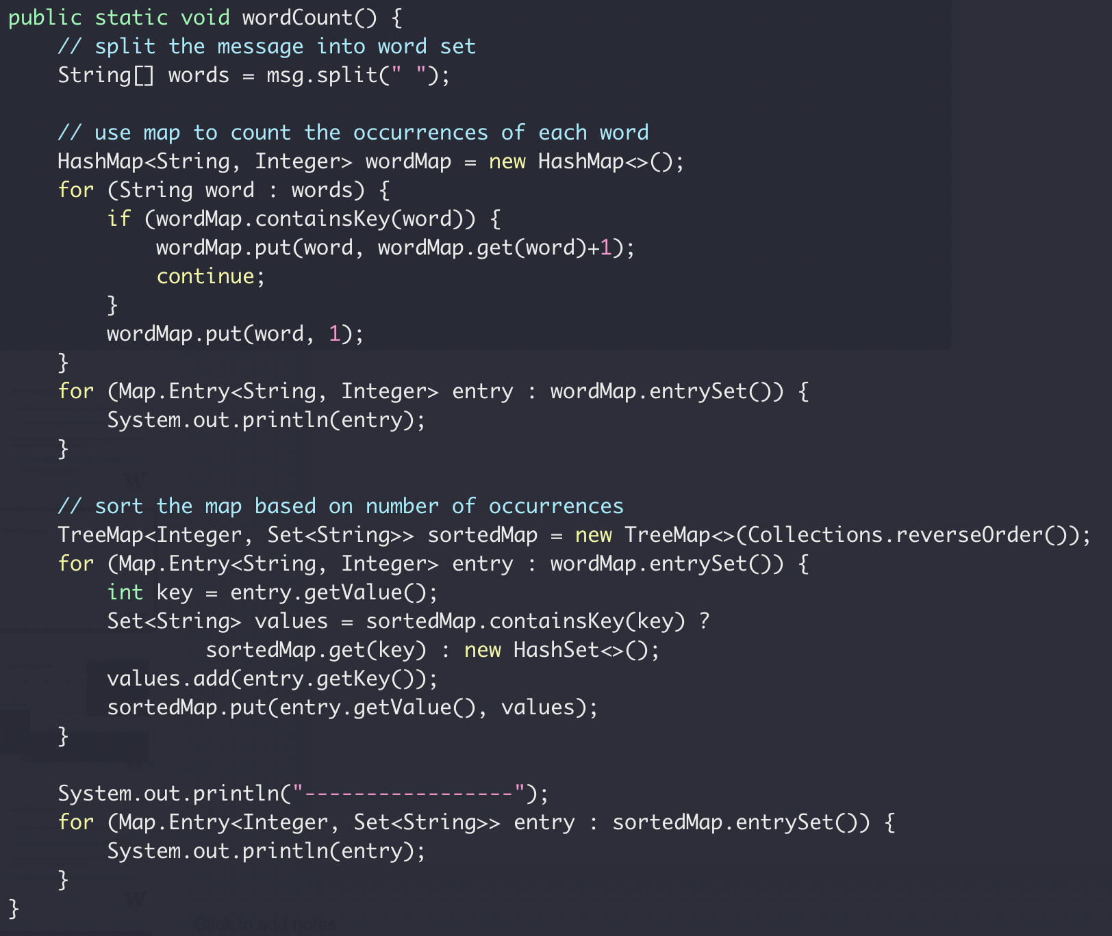
Word Frequency

Slide 46
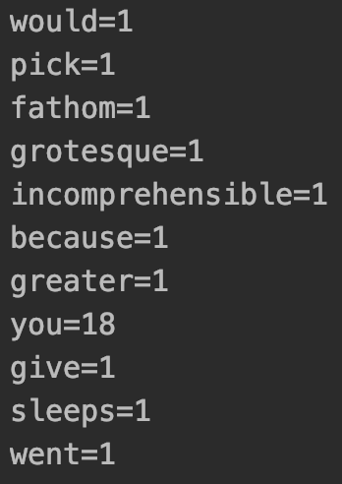
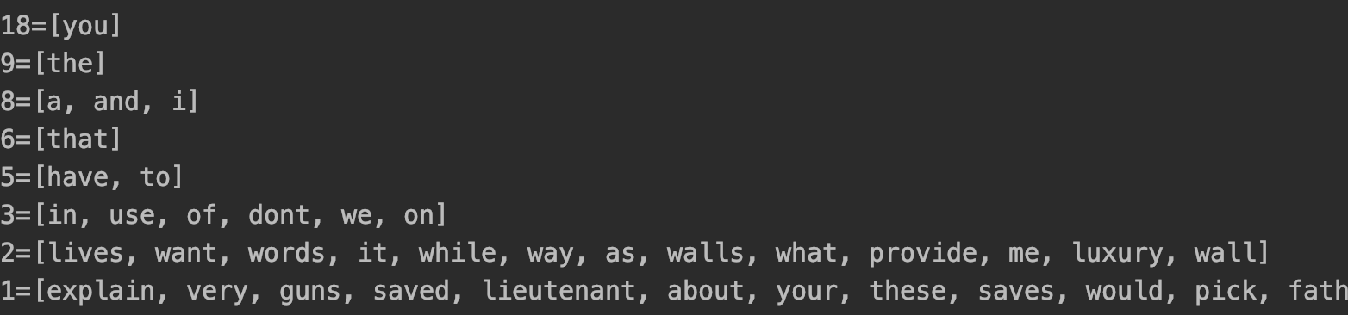
Word Frequency
Count frequency
Sort frequency

Slide 47
Word Frequency
Step 1: Count how many times each word occurs
HashMap → O(1) per insert
Step 2: Sort the result from step 1 in descending order by value (number of times that word occurs)
TreeMap → O(lgN) per insert

Slide 48
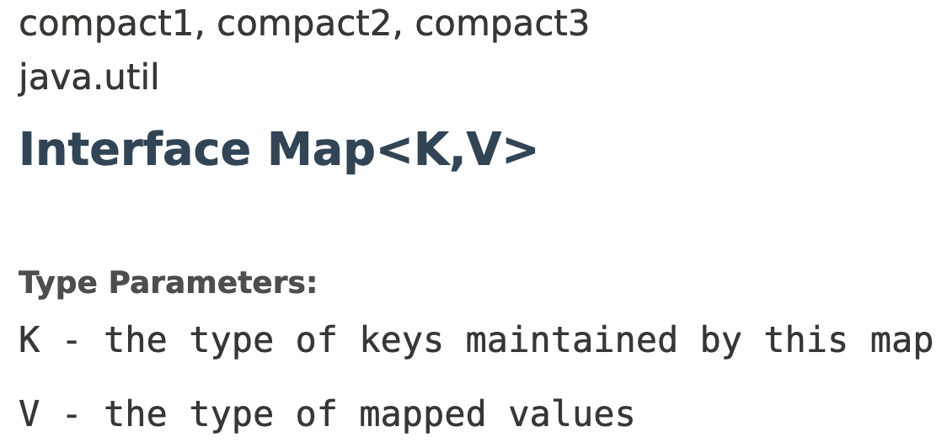
All the Maps
From Java.util
http://rkandhal.com/2014/02/16/hashmap-treemap-linkedmap/

Slide 49
One more thing…

Slide 50
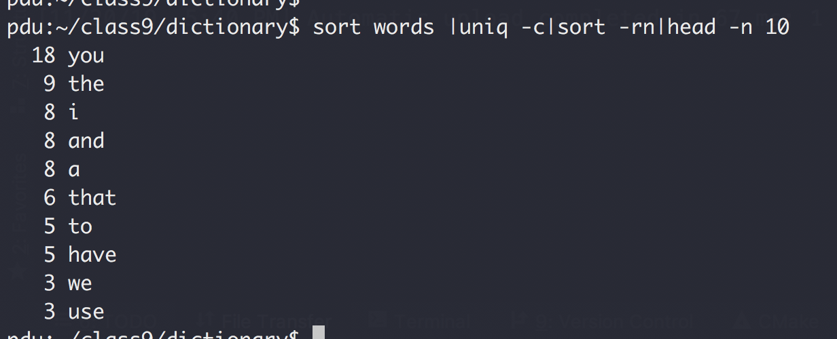
One more thing…
Boss: “I need the result in 10 minutes”

